Slide 1
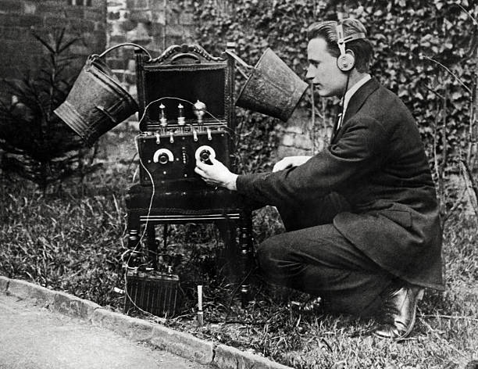

Slide 2
INTRODUCTION TO TRAFFIC HANDELING J C Smith, N5RXS
Traffic Handling Training takes more than an hour to present. Today we will look at a brief history traffic handling followed by traffic handling guidelines.

Slide 3
History
Samuel Morse invented/developed/refined Morse code 1830 to 1840.
First telegraph line was between Washington, D.C., and Baltimore, Md and activated in May 1844.
International Morse code was standardized in 1851.
The first transcontinental telegraph was completed October 1861.
The first successful telephone call was March in 1876.
The first commercial telephone exchange began operations in January 1878 in New Haven, Conn.
First wireless radio transmission across open sea, was sent by Marconi on May 1897.
Marconi transmitted radio signals across the Atlantic in December 1901.

Slide 4
History - Continued
Radio Act of 1912 marked the beginning of U.S. Federal licensing of amateur radio operators and commercial radio stations
The first transcontinental phone line was completed In June 1914
First transcontinental telephone call from New York City to San Franscisco took place in January 1915

Slide 5
History - Continued
In the early days, amateur radio transmissions were “at best,” good for a few hundred miles - IF CONDITIONS WERE GOOD
Hiram Percy Maxim had to find a relay station to get his message from Hartford, CT to Springfield, MA in March 1914
LATER THAT YEAR he was a key player in the effort to form American Radio Relay League (ARRL). One objective of ARRL was to organized a group of "relay" stations to pass messages via amateur radio.
Did you know Hiram Percy Maxim was an inventor of mufflers for internal combustion engines and the first commercially successful firearm silencer.

Slide 6
History - Continued
The number of amateur radio operators grew and technology improved. Traffic handling procedures continued to evolved.
When amateur radio returned after WWII it was obvious problems relaying and formatting messages needed to be fixed. In early 1948 ARRL’s Assistant Communications Manager, George Hart, W1NJM, was task with finding a solution to message handling issue.
The September 1949 QST announced a new National Traffic Plan.
Operations of what is now the National Traffic System began October 1949.

Slide 7
National Traffic System (NTS)
A structure that allows for rapid movement of traffic from origin to destination and training amateur operators to participate in directed nets and accurately handling written traffic.
The aim is to handle formal written traffic systematically, by whatever mode best suits the purpose at hand.

Slide 8
National Traffic System (Daily) Cycles
A complete “cycle” of NTS nets consists of the sequence of:
• Section/Local nets
• Region nets
• Area net
• Region nets
• Section/Local nets
NOTE: Section nets and Region nets meet twice during the cycle, the early sessions for outbound traffic, the later for inbound traffic.

Slide 9
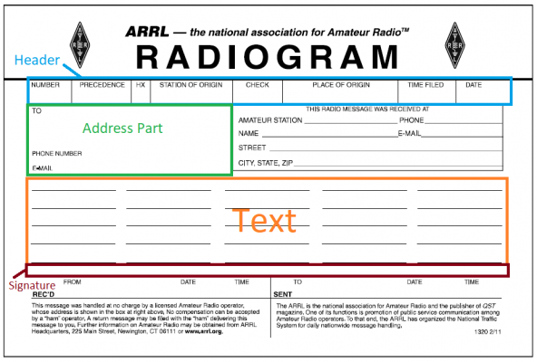

Slide 10


Slide 11
HEADER
Message Number (Mandatory)
This can be any number the originating stations chooses. Example: NR 1
Precedence (Mandatory) The Precedence of the Message determines what order the messages will be handled.
EMERGENCY (EMERGENCY) Any message having life and death urgency to any person or group of persons. (When in doubt, do NOT use this precedence.) This message are priority 1.
PRIORITY (P) These messages have specific time limits. These messages are priority 2.
WELFARE (W) Inquiry or report of welfare of an individual in a disaster. These messages are priority 3.
ROUTINE (R) 99.99% of all messages have this precedence. These messages will be handled last.
EXERCISE MESSAGES: Preceded by the word “TEST” or “EXERCISE

Slide 12
HEADER - Continued
HANDLING INSTRUCTIONS (Optional)
HXA (Followed by a number) Collect landline delivery authorized by the by addressee within ... miles. (If no number, authorization is unlimited).
HXB (Followed by a number) Cancel message if not delivered within ... hours of filing time; service originating station.
HXC Report the time and date of delivery to originating station.
HXD Report to the originating station the identity of the station from which you received, plus time and date. Report the identity of the station to which it was relayed, plus time and date, or if delivered report time and date of delivery.
HXE Delivering station get a reply from the addressee, and originate a message back.
HXF (Followed by number) Hold delivery until ... (date).
HXG Delivery by mail or landline toll call not required. If toll or other expense involved, cancel message and service originating station.

Slide 13
HEADER - Continued
CHECK (Mandatory)
This is a count of the number of words used in the TEXT (only) of the message. The address or signature are NOT counted. Both the sender and receiver should end up with the same word count or (CHECK).
STATION OF ORIGIN (Mandatory)
This is the call sign of the Amateur Radio Station originating this message.

Slide 14
HEADER - Continued
PLACE OF ORIGIN (Mandatory)
This field is the City and State of either the Station of Origin or the person in the Signature.
TIME FILED (Optional)
The time the message was originated. You may either use UTC or Local time
DATE (Mandatory)
This is the date the message was originated. In Amateur Radio, we use month and day.

Slide 15
ADDRESS - FULL
First and Last Name
Street Address and Suite or P. O. Box number
City, State, and Zip Code
Telephone Number and/or Email Address

Slide 16
TEXT
Limited to 25-word groups – 5 across, 5 down
PUNCTUATION ALLOWED
/: The slash, "/"
X: The letter "X" used to denote a period.
R: The letter "R" is used in place of a decimal.

Slide 17
TEXT - Continued
OTHER PUNCTUATION – SPELL OUT
"QUERY" for a question,
"DASH" to separate special number or mixed groups
"EXCLAMATION"
"COMMA“
HYPENS ARE NOT used in telephone number groups

Slide 18
TEXT - Continued
"Q"-SIGNALs are permitted
Ciphers, codes, encryption, and other groups intended to obscure the meaning, are not allowed.
SALUTATIONS: Words like "love" and "regards", are put in the text in amateur messages (not in the signature).

Slide 19
Signature
Signature of the sender

Slide 20
ARL Numbered Radiograms
ARL messages are encoded as one or two numbers, some with option blanks to be filled out in the text, to permit many words to be condensed to a few.
These numbers are always spelled out in the written message and in transmission, and are always preceded by the letters "ARL", as in “ARL FIFTY SIX” in the text.

Slide 21
Example - Message count is ARL 17
ARL FIFTY SIX NEW AMATEUR
LICENSE X PLEASE CONSIDER GETTING
INVOLVED WITH NTS MESSAGE HANDLING
X 73

Slide 22
Translate ARL FIFTY SIX before delivery
Congratulations on your NEW AMATEUR
LICENSE a most worthy and
deserved achievement X PLEASE CONSIDER
GETTING INVOLVED WITH NTS MESSAGE
HANDLING X 73

Slide 23
Learn more by visiting these web pages
Texas Traffic Net
7290 Traffic Net
Go to the 7290 web site, https://www.7290trafficnet.org/ select “training” and download the traffic handling file
Tune in to one of the 7290 training sessions

Slide 24
My Recommendations
Tune in and listen to traffic nets.
Visit web page for Texas Traffic Net and 7290 Traffic Net to find net times and frequencies.
Check in – you are not required to take traffic
These are managed nets, always follow net controls instructions
Download and study the traffic handling file.

Slide 25
My Recommendations – Continued
If When you decide to handle traffic:
Keep handling instructions near by and follow instructions
If you take a message, complete the delivery process OR return message

Slide 26
My Recommendations – Continued
When you call recipient – leave a message with your name and call, phone number, and reason for call
If incorrect phone number, go to QRZ and see it the recipient has an email address listed
When delivered comply with senders reply instructions
If the recipient can’t be contacted, service the message

Slide 27
Questions

