Slide 1
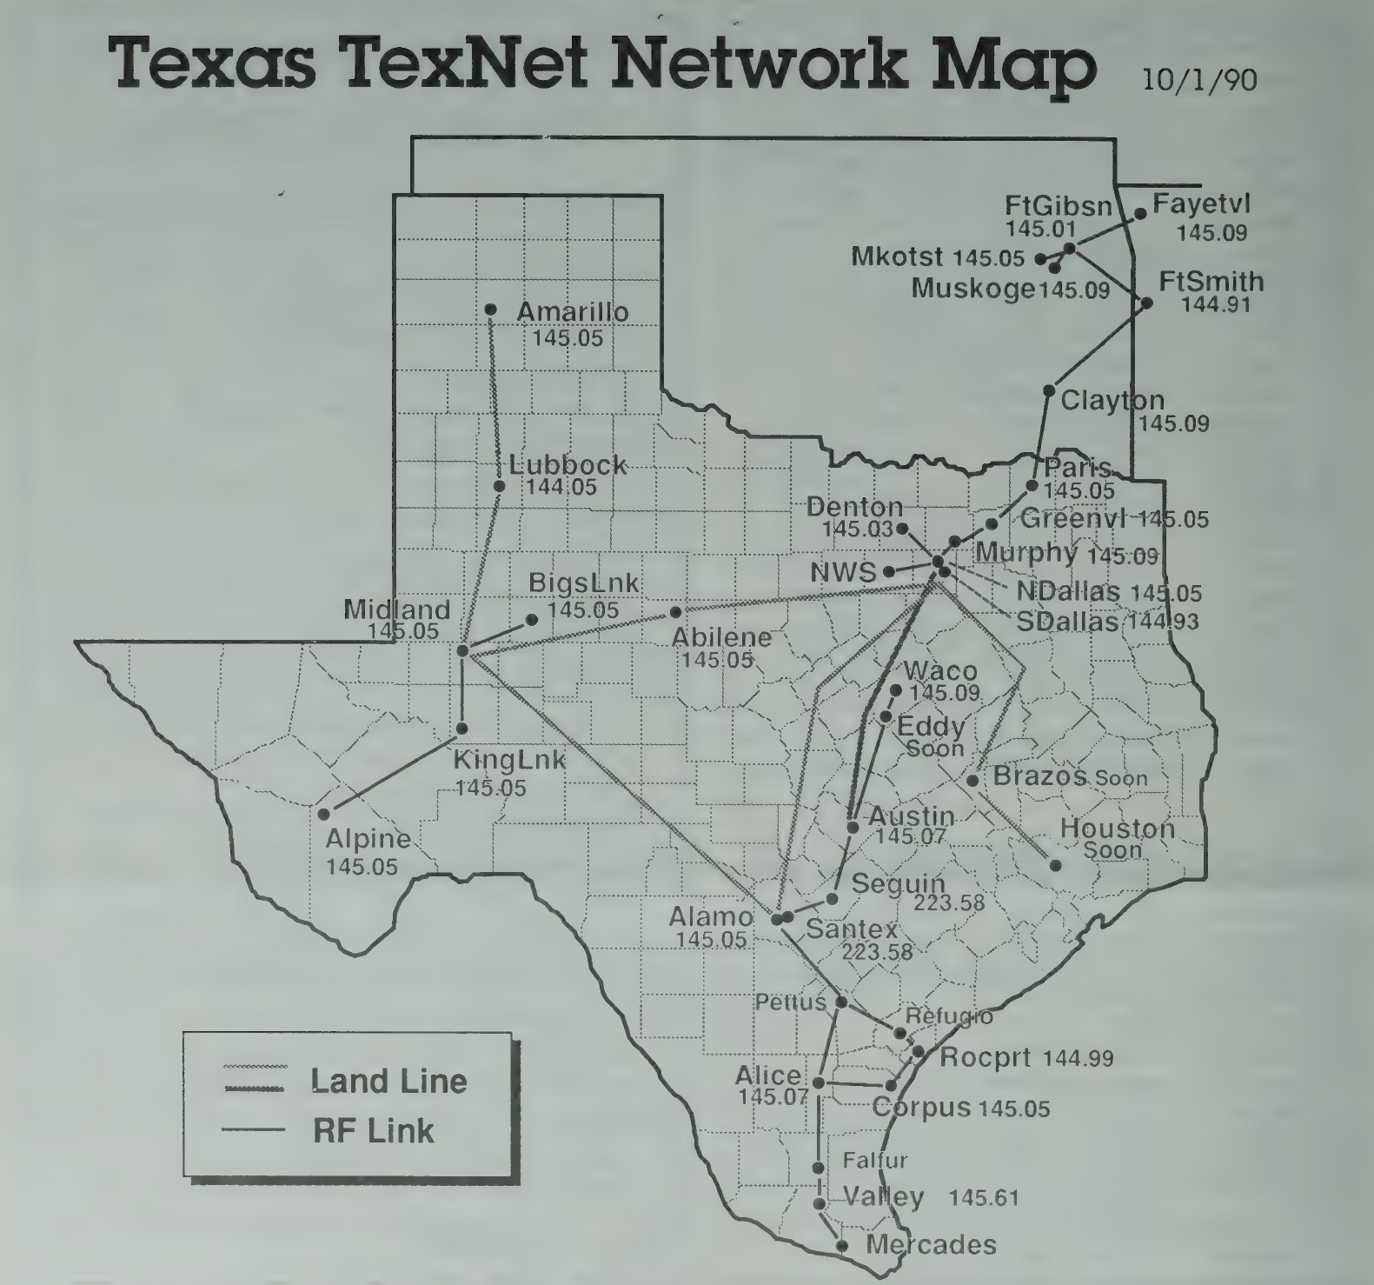
Texnet: A Brief History
An Overview of the Hardware, Development, and Challenges

Slide 2
The Hardware
Z80 CPU with onboard 9600 and 1200 baud MODEMs
NRZ FSK Modulation for 9600 baud
5 KHz Deviation
Hardware remote reset - Firecode
TTL bit control for frequency switching
Header for external MODEM (wireline/second 1200 baud)

Slide 3
The Two Toms
Tom McDermott, N5EG and Tom Aschenbrenner
Aschenbrenner wrote the original code
McDermott and others built/tested hardware
Maintained code, added features:
– Conference Bridge
– 5MB Hard Drive Support
– Packet Message System
– Ability to collect and display weather data

Slide 4
The Data Radio
Recovered from Dallas trash trucks (RCA 700)
Vericap diode used to directly modulate the crystal
Pin diode TX/RX switch
Helical Coil Resonator makes the IF almost to narrow
Order Wire switch for voice comms site to site

Slide 5
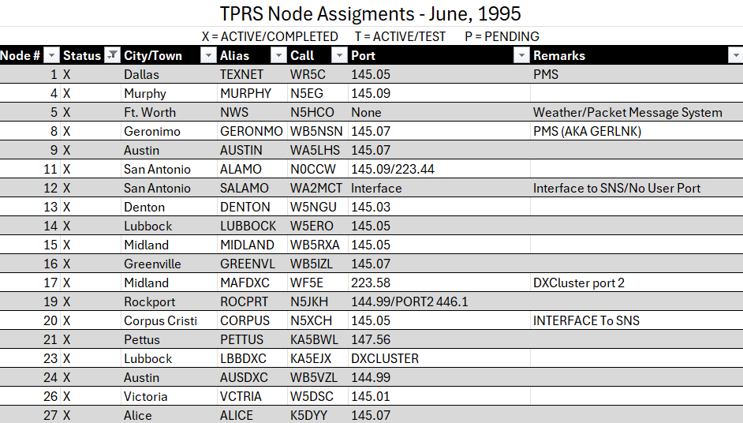
Node List

Slide 6
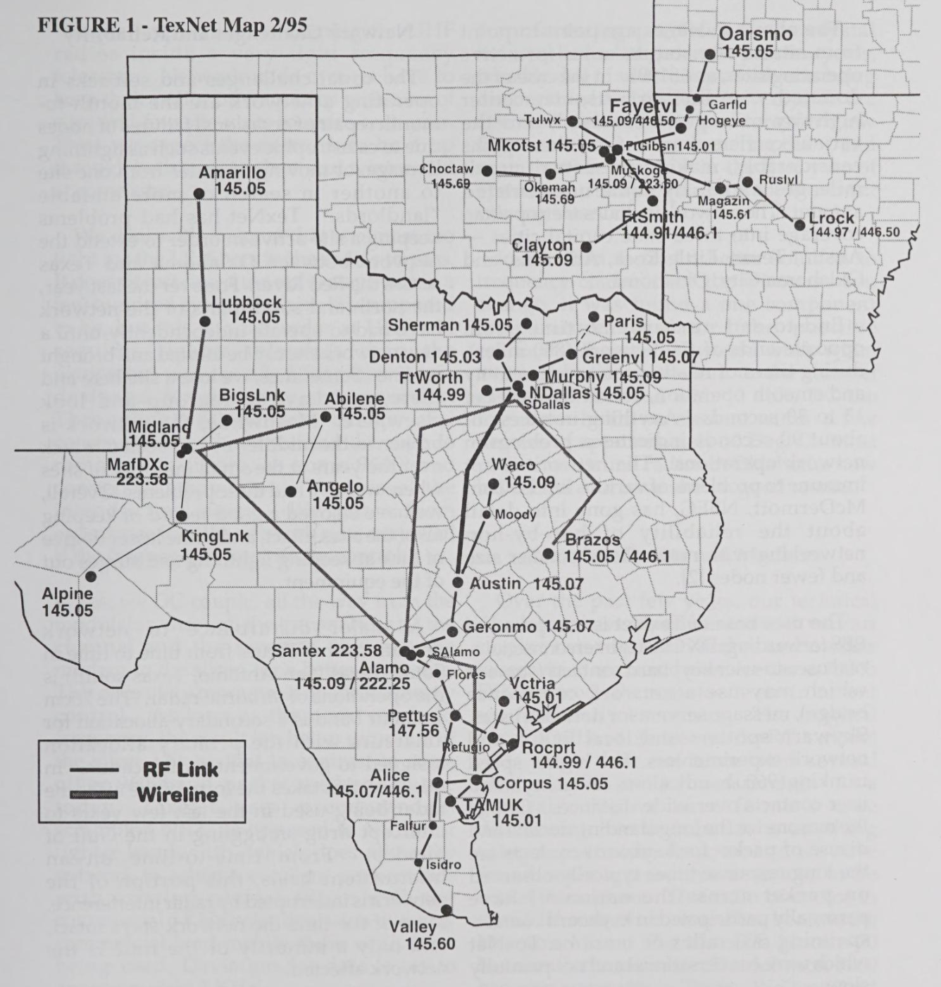

Slide 7
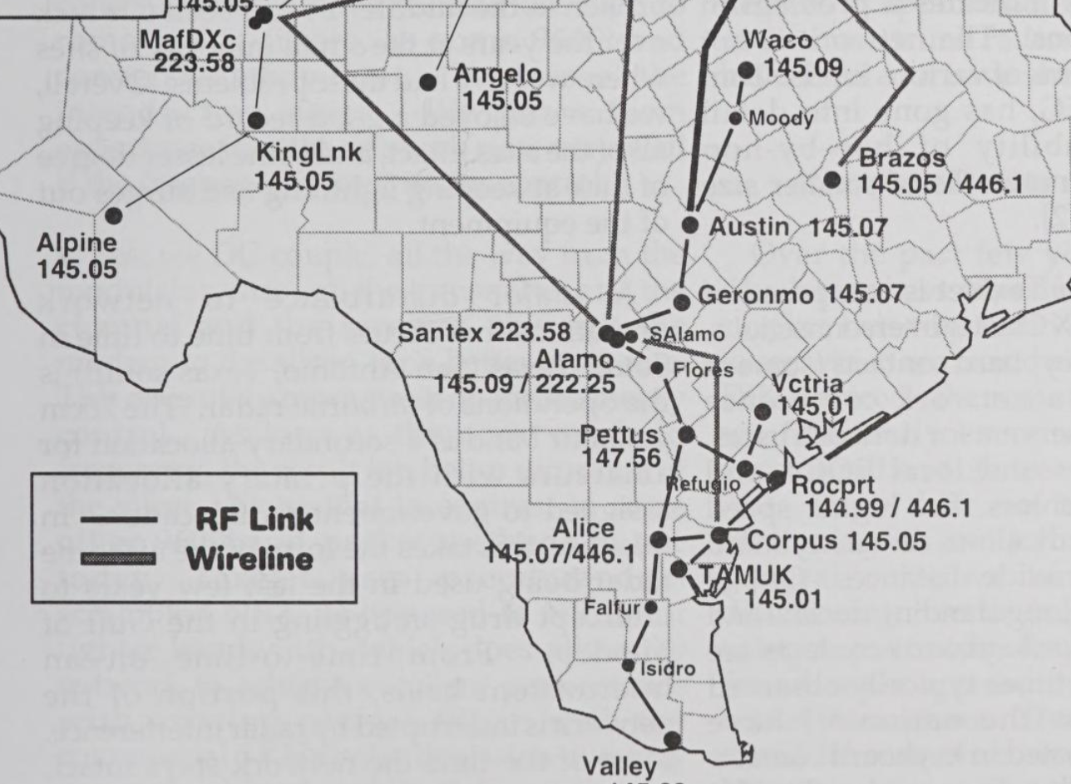
South Texas Texnet

Slide 8
What Can Stop the Network?
Bees?
Strange signal wipes out 446.1 MHz 9600 baud network over a very wide area.
At times it was a 350-mile footprint
The Spectrum Analyzer shows wavy grass
Call the FCC
We are not primary on the band

Slide 9
A 100% path 99% of the time??
There were times that we had 100 percent packet drop between two sites about 65 miles apart.
Testing showed that there was plenty of signal to support the network
What is happening to the S-Meter voltage?
Classic Interference Pattern

Slide 10
A Two Meter Frequency path that drops a lot of packets
In the town of Refugio, we had a hop for the 9600 backbone to support Texnet Victoria-Pettus-Rockport were reachable - TexNode
We put a local NETROM node in Refugio to support local two-meter activity. It was awful.
Packets dropping all over the place, why?
The path was great
What is that noise??

Slide 11
How NOT to run Feedline
We had a 300-foot tower location in Rockport
I had not considered shrinkage.
Cold ripped the coax jumper in two.

Slide 12
SWR looks great at 445.1 MHz but something getting worse
Pettus was having issues
Don Galloway K5DYY came up from Alice to assist
SWR was great. 19 watts forward .25 watts reflected.
Tested at the top of the coax was 8 watts???
Water got in the connector at the top of the coax.
Weller Pyropen for the win.

Slide 13
Other Items
Tropospheric Ducting
Routing Lockout Table

Slide 14
Questions?
Radioteacher ((at)) gmail.com

