Slide 1
SADRC Presentation Feb 17th, 2024 Presented by Doug - N8IQT

Slide 2
Agenda
Overview of Wires X and YSF. We will not focus on any other digital modes in this presentation.
Wires X
YSF
Bridging YSF to Wires X
Shark Open, Spot, Pi-Star, and Digital Thumb DV
Yaesu capable equipment
Yaesu Digital Repeater and Wires X Box (HRI-200)

Slide 3
What is Wires-X
Wires X – (Wide-coverage Internet Repeater Enhancement System) is an Internet communication system which expands the range of repeaters and nodes.
WIRES-X Node - An amateur “Node” station is where you use of one of Yaesu’s C4FM Fusion model radios connected to the internet using Yaesu’s software to link world-wide.
Amateur stations can communicate with other amateur stations using a node radio either on RF simplex or direct using a microphone. This is referred to as a PDN. (see next bullet below)
PDN – Personal Digital Node – Capable of using your own C4FM Fusion radio to connect to Wires X without going through a repeater.
A Wires X box (HRI-200) is only required when operating a room capable of having multiple connections generally used for repeater applications requiring several inbound connections.

Slide 4
YSF (Independent Network)
YSF - Short for Yaesu Fusion. It is an open-sourced software and managed by amateurs who update the code from time to time. It is not a Yaesu or Wires X product as many people believe.
Unlike Yaesu Wires X, there is no central management server or management of rooms. There are directories of YSF Servers.
YSF CAN NOT directly connect to Wires X on a Yaesu
Fusion repeater network without a bridge!
In order to connect a YSF server to Wires X, SADRC bridges the 2 connections using a Shark Open Spot.

Slide 5
What is Bridging?
A bridge is a way of connecting 2 different protocols or technologies together.
Since YSF can’t directly talk to Wires X, a bridge is required so that signals can be heard on both YSF and Wires X.
When a signal is heard on YSF server, an Open Spot or PI-Star unit is located at the repeater site and transmits to the Yeasu repeater. When it hears a signal on YSF it transmits out on Wires X (bridging the 2 protocols together).

Slide 6
Ways to Connect to SADRC!
VHF & UHF Repeaters linked to Texas SADRC
Wires X Software and PDN Node – Texas SADRC Room #40324
YSF Network – US SADRC (Reflector #84398) using an RF Shark or Pi-Star
Digital Thumb DV - No transceiver required. Operates off your computer and external microphone.

Slide 7
RF Shark OpenSpot

Slide 8
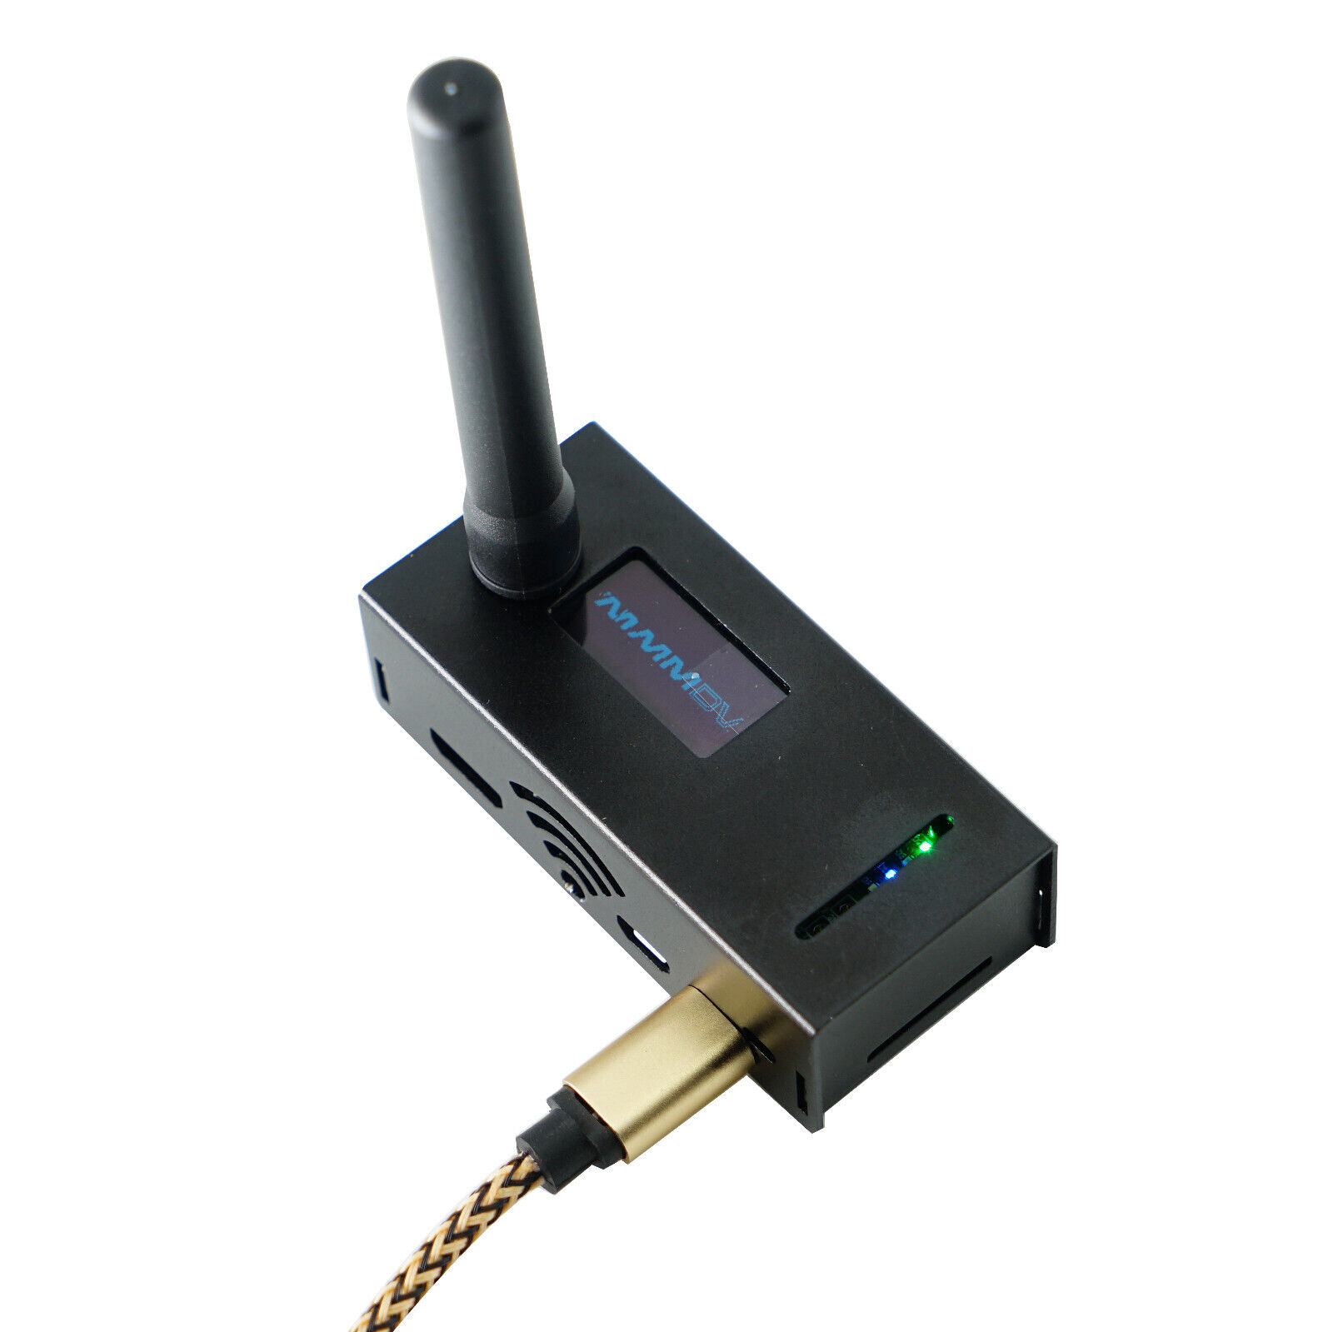
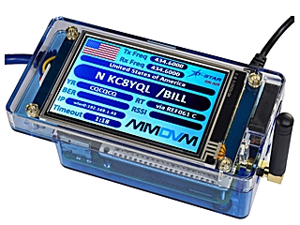
Pi-Star Hot Spots

Slide 9
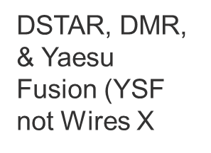
DB3000U Digital Thumb DV
Thumb DV
nwdigital@radio.com
No transceiver required. Need computer and external Microphone.

Slide 10
YSF & Wires X Dashboards
YSF Reflector Dashboard
https://www.pistar.uk/ysf_reflectors.php
Wires X Active Nodes
WIRES-X ACTIVE NODE ID list (yaesu.com)
Will conduct a live demonstration of Wires X and YSF at end of this presentation.

Slide 11
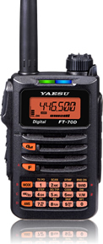
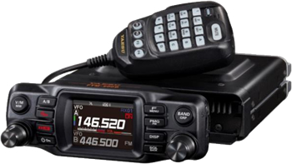
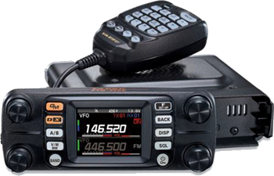
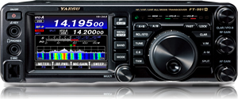
Yaesu C4FM Current 2024 Models
FTM-500DR
FT-5DR
FT-70DR
FTM-200DR
FTM-300DR
FT991A

Slide 12
System Fusion Repeater and HRI-200
DR2X State of Art C4FM Repeater
HRI-200
HRI
**You do NOT require the Wires HRI-200 to connect to a Wires X room. You simply connect your HT or mobile radio to a PC and download the Wires X software. You will need to obtain a Wires X ID from Yaesu in order to operate. This is known as a PDN (Personal Digital Node). The HRI-200 is required to have multiple connections such as Texas SADRC #40324 with 20-30 repeaters connected.

Slide 13
Texas SADRC Wires X Room Repeaters What is a Wires X Room?

Slide 14
SADRC Network
YSF Server and Software Upgrade
SADRC Repeater Network Linked to SADRC
Clubs and Independent Repeaters
Select Heat Maps (coverage maps)
New Repeater Site Opportunities
Live Demonstration
Q&A – Wrap up!

Slide 15
YSF Server and Software Upgrade
Current YSF server is being decommissioned and we will be upgrading to a new server and updated YSF software.
Team was set up to review all server options and costs.
Stability of the network connection and software are key!
K9EQ of the MNW group has written new code to provide us with the most stable operating software.
Plan is to use a high-speed server with redundancy out of NY. Chris K9EQ will manage the software, upgrades, as well as the server
A dashboard will be available to allow our group to view who’s connected on YSF

Slide 16
SADRC Repeater Network Wires X 40324, YSF US SADRC

Slide 17
Other Club Partners
Clubs or Independent Repeaters linked to Texas SADRC
Kendall Amateur Radio Club (KARS) Boerne, TX
444.900 & 444.925
MCARC – Hondo – 443.350
KA5C – University of Texas – Austin - 442.150
NU5DE – McDade 441.575
K7RHT – Kerrville – 147.040 (New)
K5ENT – Corpus Christi – 442.575

Slide 18
New - 443.200 - SW San Antonio - WS5DRC

Slide 19
147.160 N. Bexar County – N8IQT

Slide 20
442.750 N. Bexar County – N8IQT

Slide 21
440.275 Blanco/Comal – WS5DRC 281 at 306

Slide 22
147.160 Round Rock – K5UUT

Slide 23
147.040 Kerrville - K7RHT

Slide 24
442.575 Corpus Christi – K5ENT

Slide 25
New Repeater Site Opportunities
Llano, TX – SADRC - 147.220 – Planning in 2024
Corpus Christi – STARC Club. 146.880 – 600 Foot tower. Exploratory discussions.
San Angelo, TX – WM5L - 444.525 PL 162.2 AMS mode. Connecting to SADRC – April 2024
I35 Project - NE San Antonio – TBD
N. Loop1604/281 Project –TBD – Possibility

Slide 26
SADRC - 147.220 Llano – 2024 Project 300 Foot TV Tower

Slide 27
147.220 Llano &147.160 Round Rock

Slide 28
N. Loop 1604/281 Opportunity

Slide 29
Live Demonstration
Wires X – Live Demonstration and dashboard view.
YSF – Live demonstration and dashboard view.
Visual understanding of how we bridge these two modes on SADRC.

Slide 30
up. 0
Q&A
Wrap up

